Slide 1
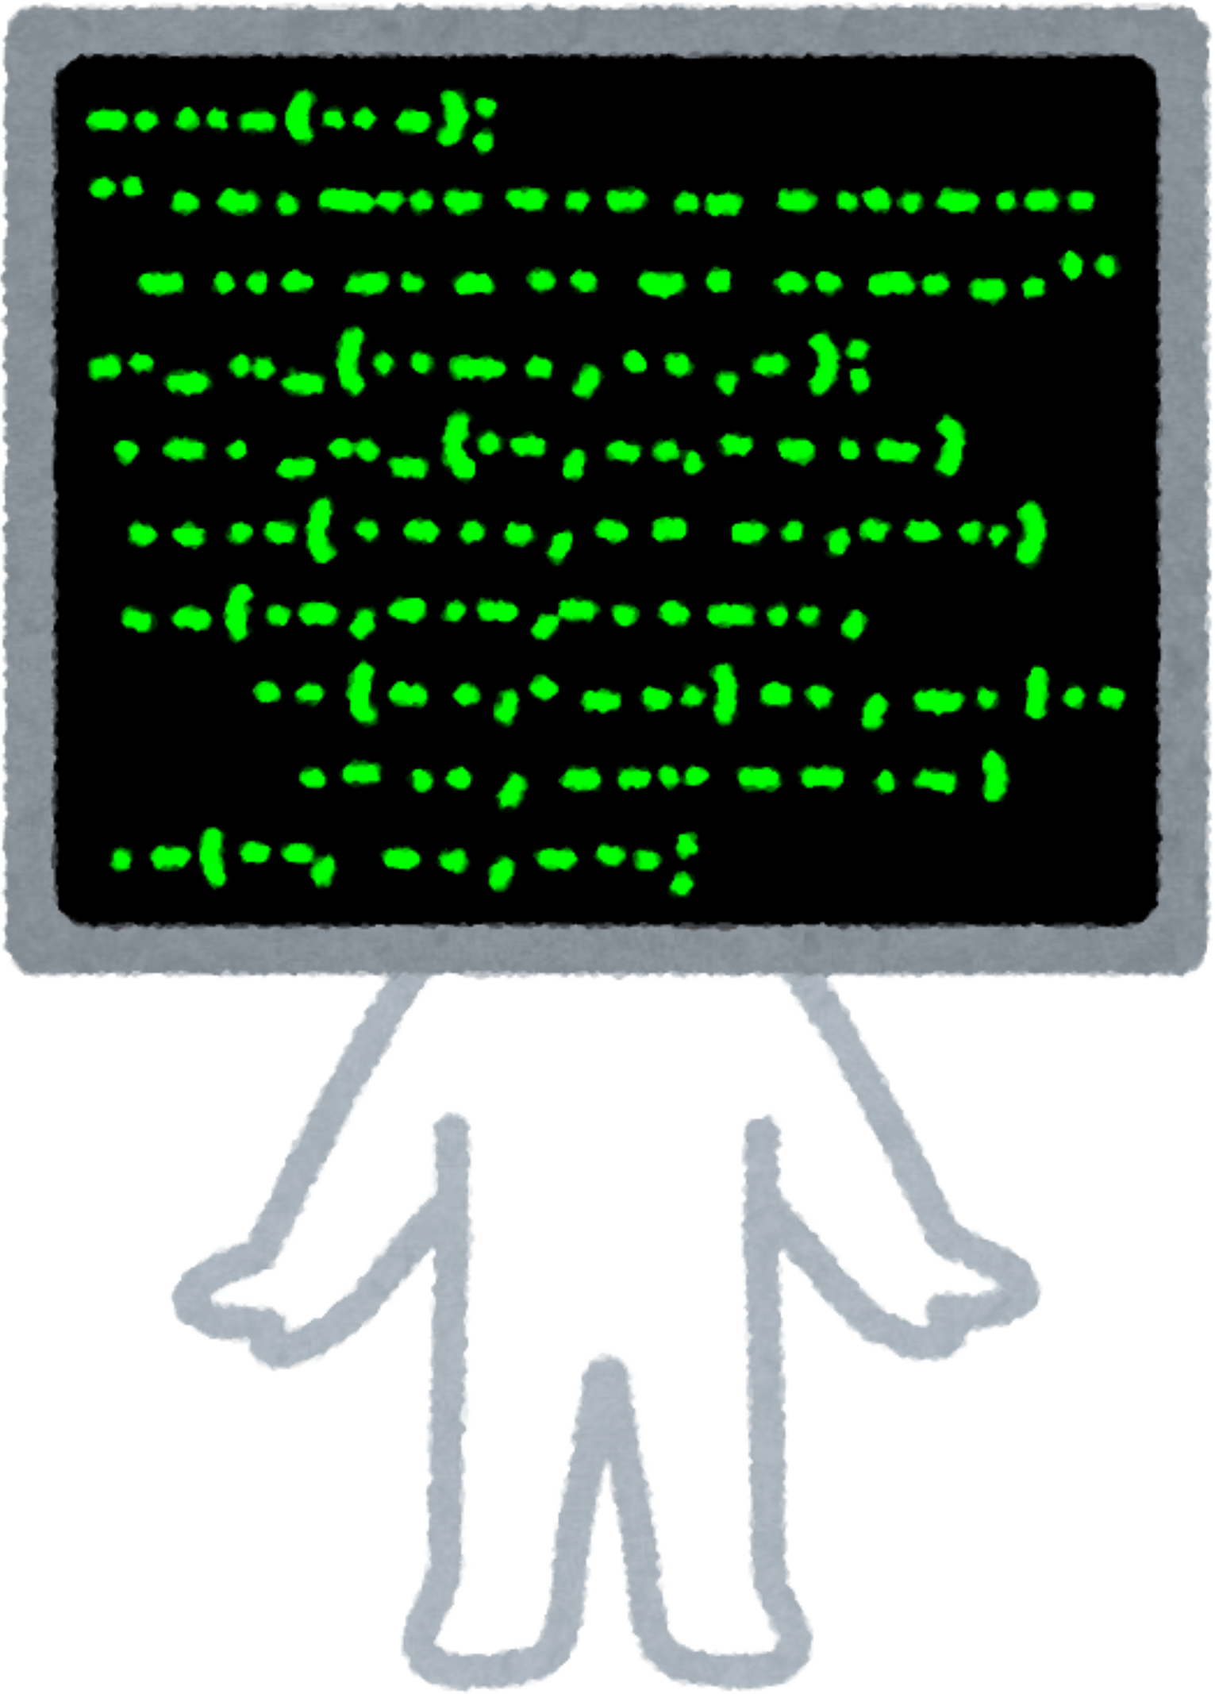
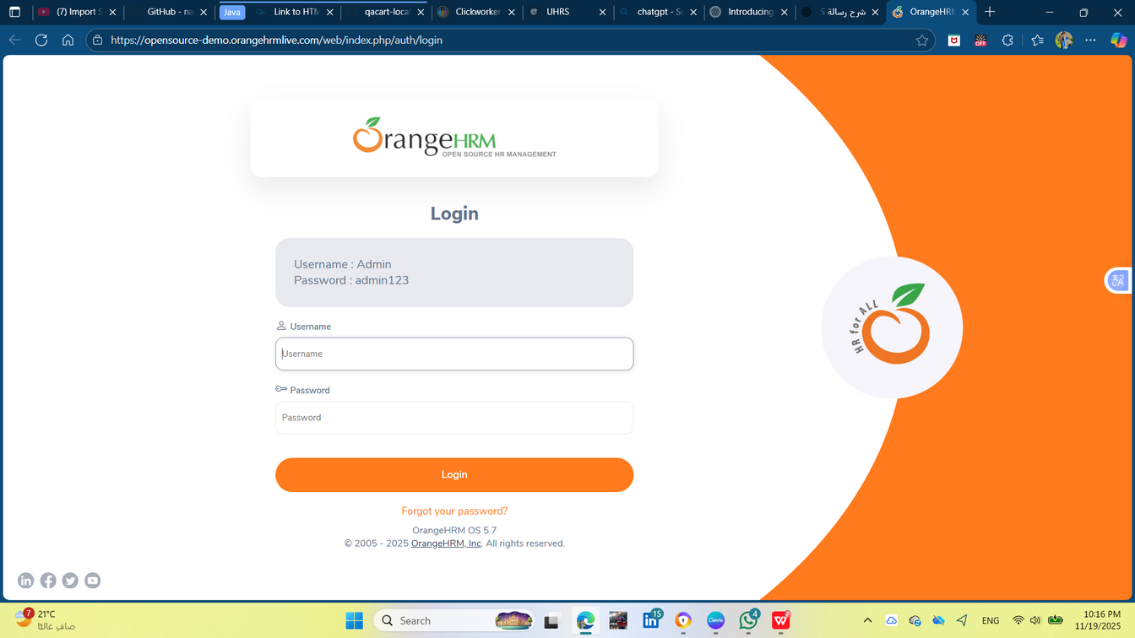



OrangeHRM Testing Project
Presented By
Shaimaa Ahmed Mohamed
Nada Ahmed Mohamed
Nada Eid Shaban
Ohood ali mahmoud
Fatema Elzahraa Ibraheem Mahmoud
Hadeer

Slide 2


Project Scope
The project focuses on testing the core modules of OrangeHRM Web Application: Login, Admin, Employee Management, Leave, and User Info.
Ensuring the system supports secure login, accurate employee data handling, proper leave application flow, and correct logout functionality.
Both manual and automation testing were performed to validate functionality, usability, reliability, and regression stability.

Slide 3
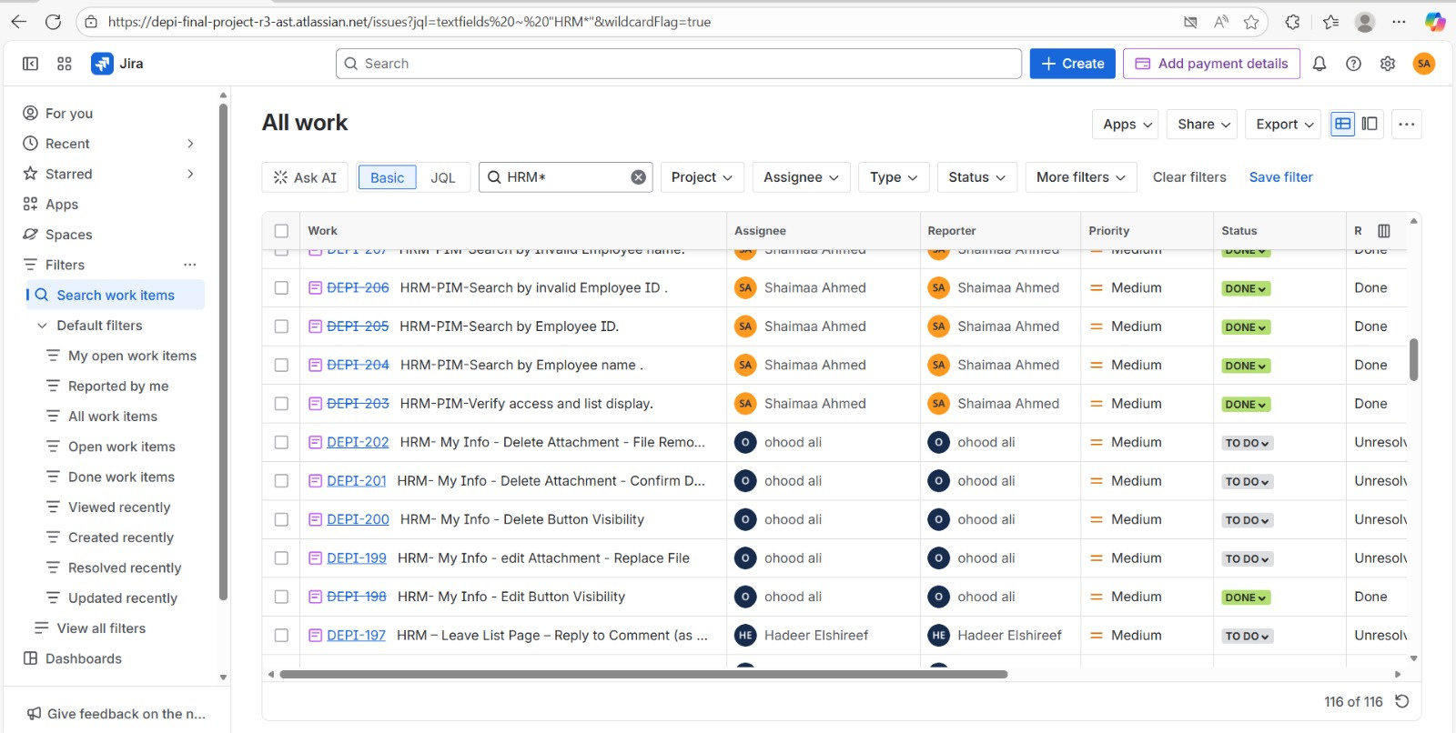
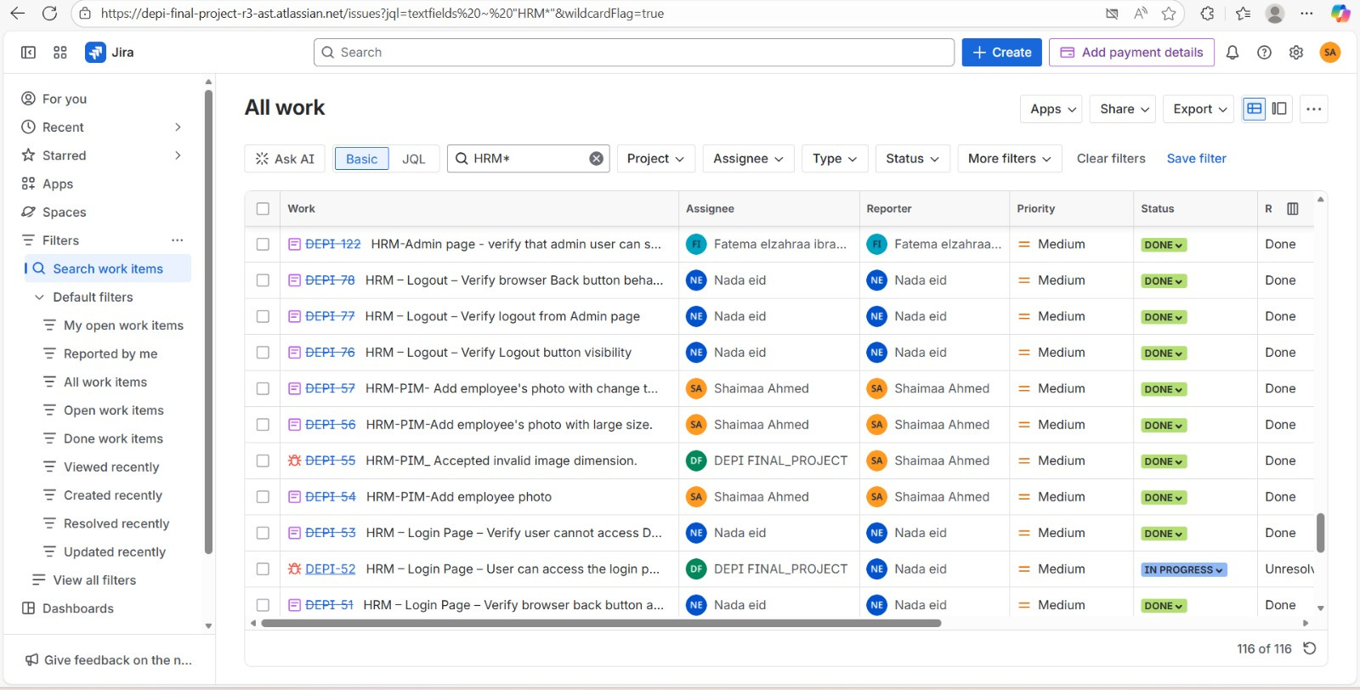
Manual Testing Coverage & Highlights
Covered all main workflows, including
Valid & invalid login scenarios
Add / Edit / Delete employee
Apply leave & check leave status
Update personal details
Admin role permissions
Designed detailed test cases, executed them, and logged defects.
Identified several UI issues, validation problems, and workflow inconsistencies during the manual phase.

Slide 4
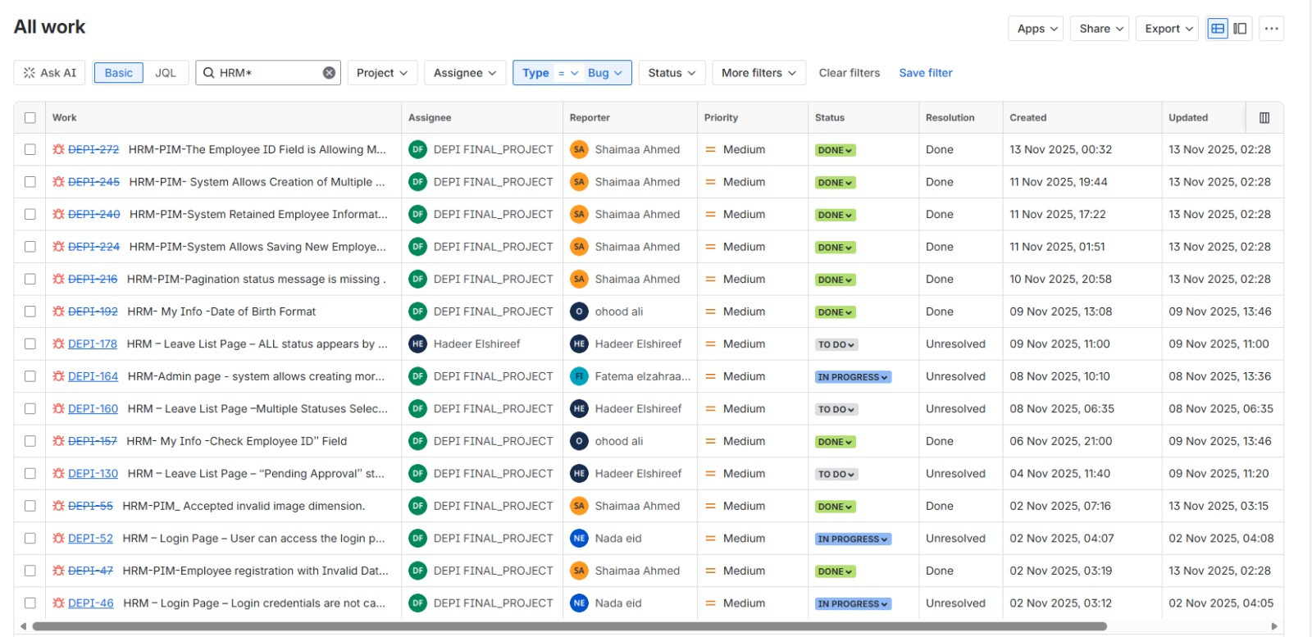
Overview of Reported Issues
The following screenshots highlight the bugs identified during the manual testing phase.
Bugs were logged on Jira, including severity, priority, and steps to reproduce.

Slide 5
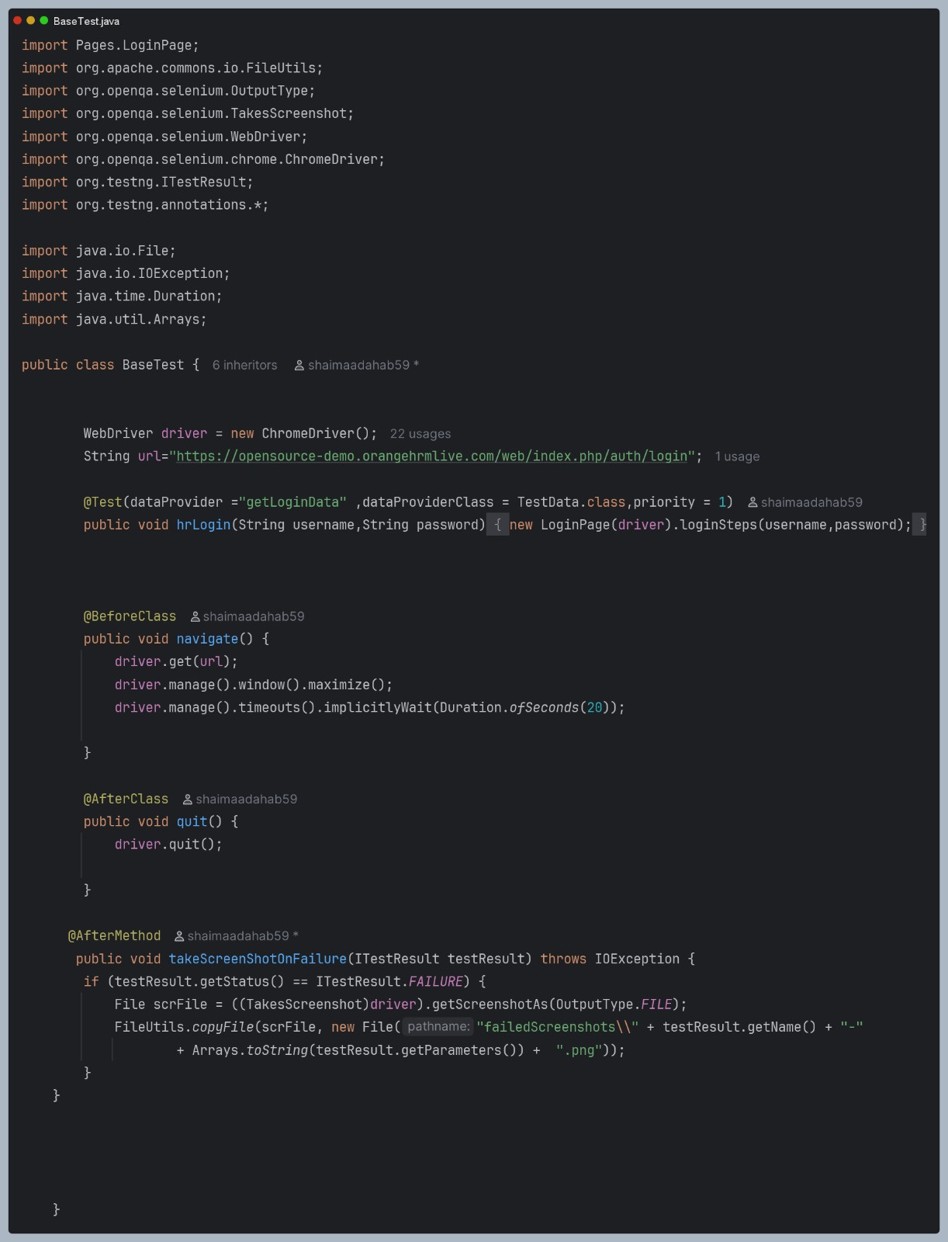
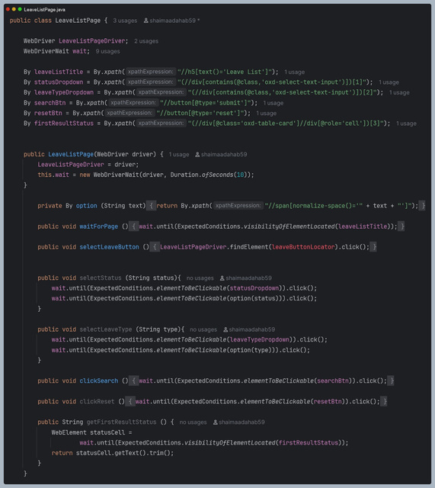
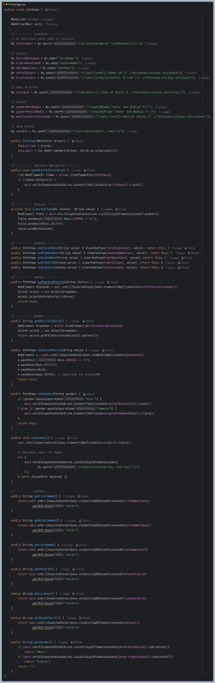
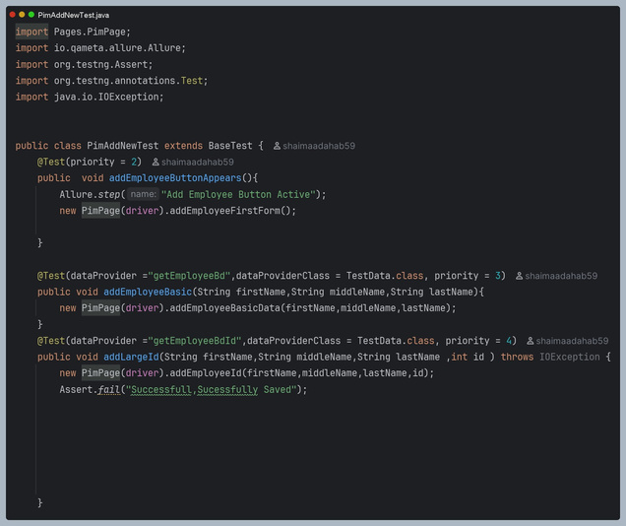
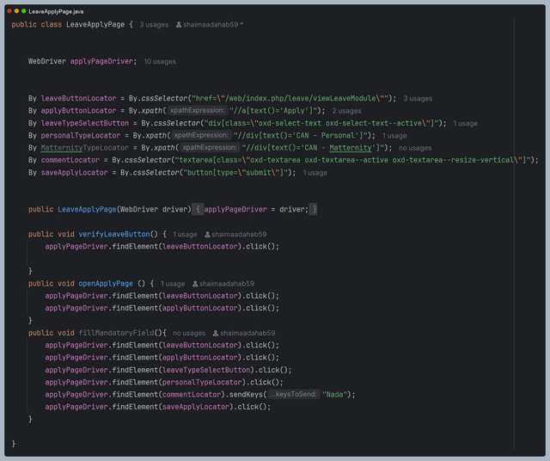
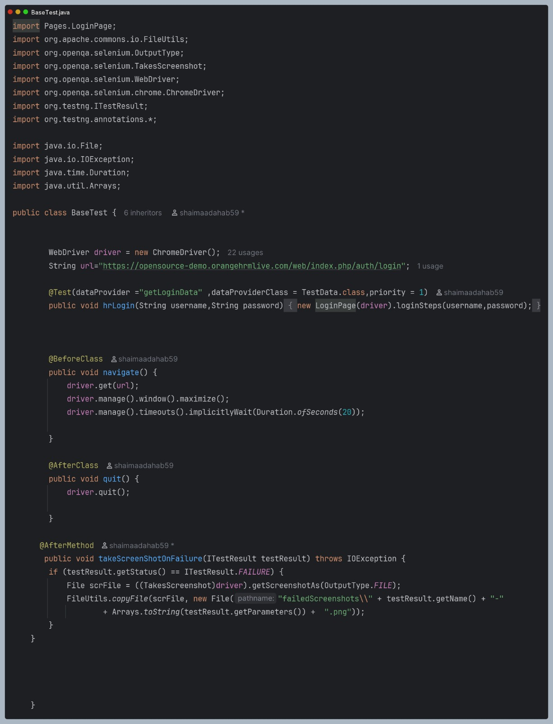
Automation Architecture & Demo
Automation implemented using
Selenium WebDriver + Java
TestNG Framework
Page Object Model (POM)
Maven for dependency management
Allure Reporting for detailed results & screenshots
Automated critical scenarios:
Login with valid credentials
Add new employee
Apply leave
Logout
Framework designed to support scalability, reusability, and easy maintenance.

Slide 6
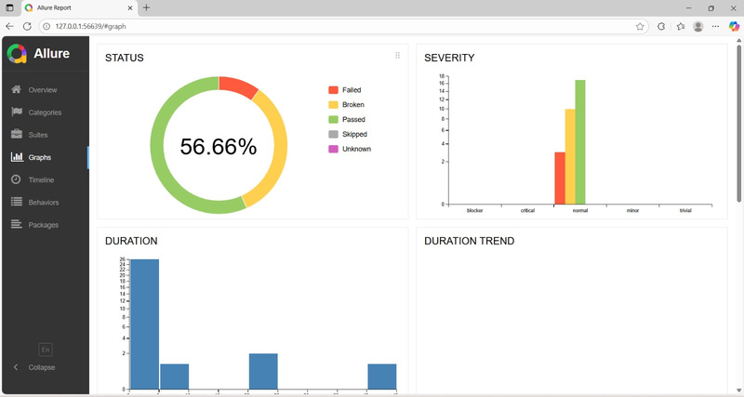
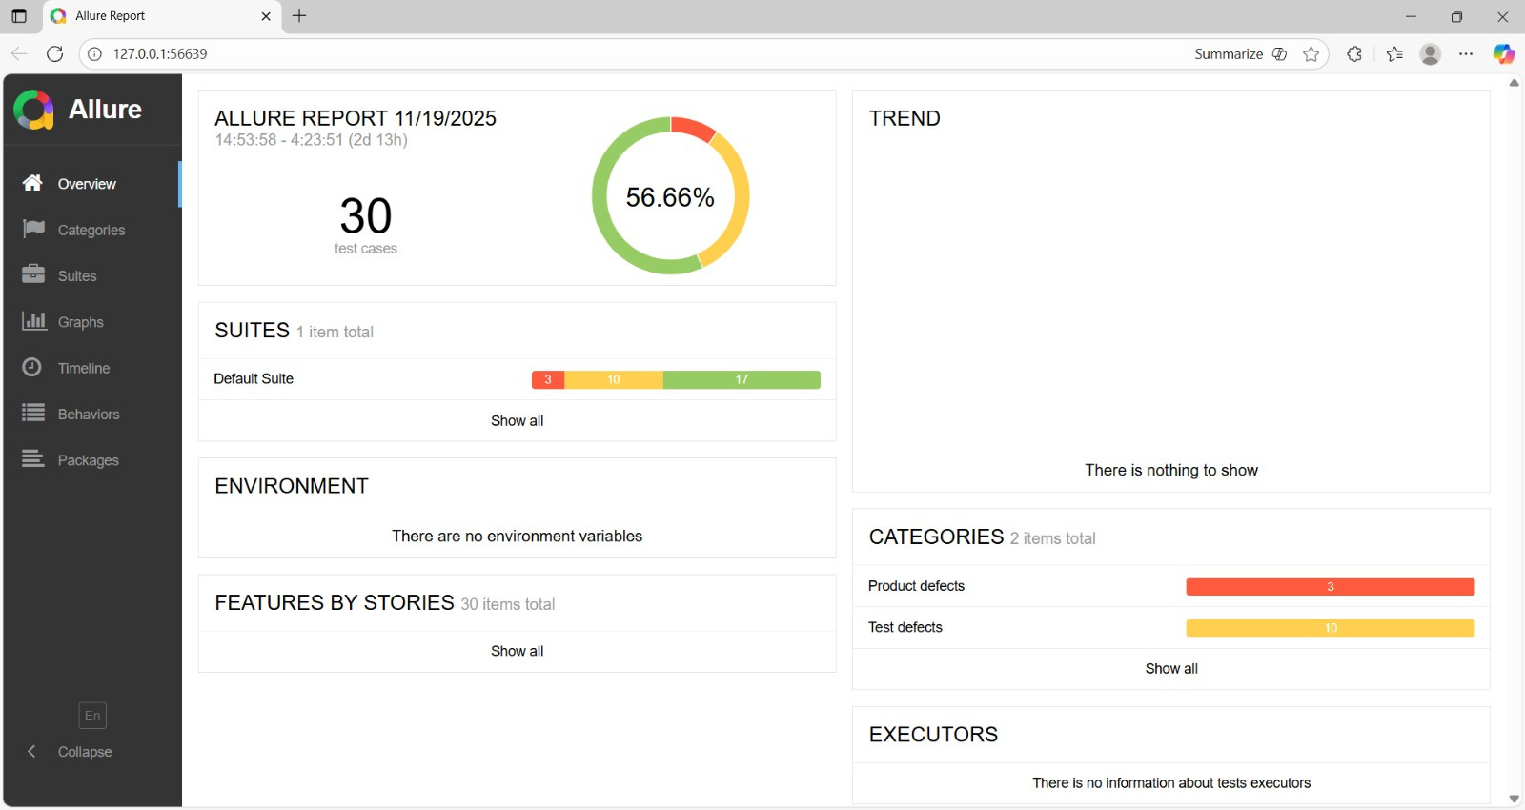
About Allure Reporting
Allure provides a detailed, visual report for the automated test execution.
It includes test case results, steps, attachments, logs, and screenshots on pass/failure.
Helps in quickly identifying failures and analyzing trends.
Allure Report Overview

Slide 7



Manual Testing Challenges
The website was unstable and would crash frequently, disrupting test execution.
During manual testing, some team members experienced disappearing leave requests, preventing them from completing the workflow.
Complex scenarios required multiple user roles to validate, making coordination harder.
Team & Process Challenges
Challenges Faced
Coordinating test execution among team members while dealing with unstable features.
Maintaining clear documentation of steps and expected results to reproduce issues effectively.
Thynk Unlimited

Slide 8

Lessons Learned
Team Collaboration:
Working closely as a team increased test coverage, helped uncover critical issues faster, and ensured consistent understanding of workflows.
Effective Reporting:
Implementing Allure Reports provided visual insights, detailed execution steps, and screenshots for both passed and failed tests, improving transparency.
Adaptability & Problem Solving:
Handling unstable website behavior, disappearing data, and dynamic workflows taught the team to adapt scripts, improve synchronization, and anticipate issues proactively.
Continuous Improvement:
Lessons from this project can be applied to future projects to streamline test planning, automation, and reporting.

Slide 9

Thank You

